Slide 1
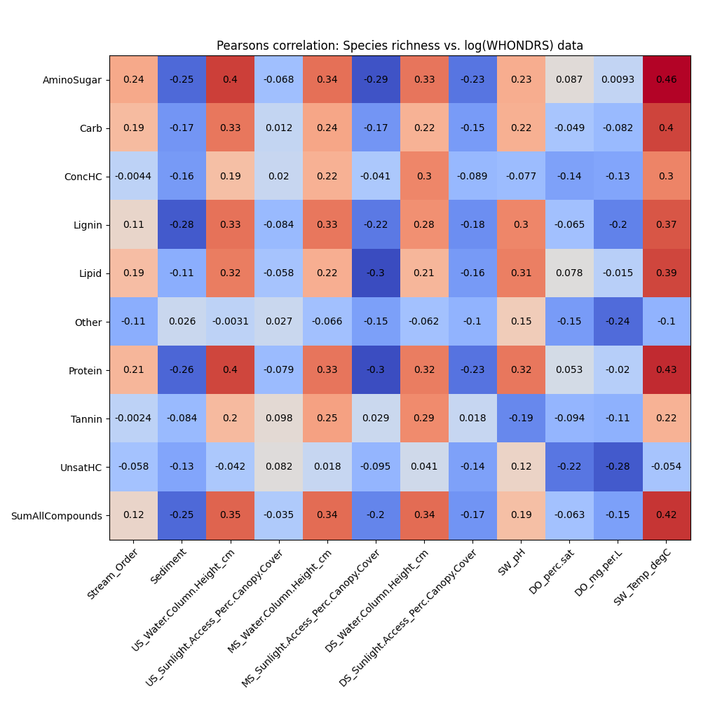
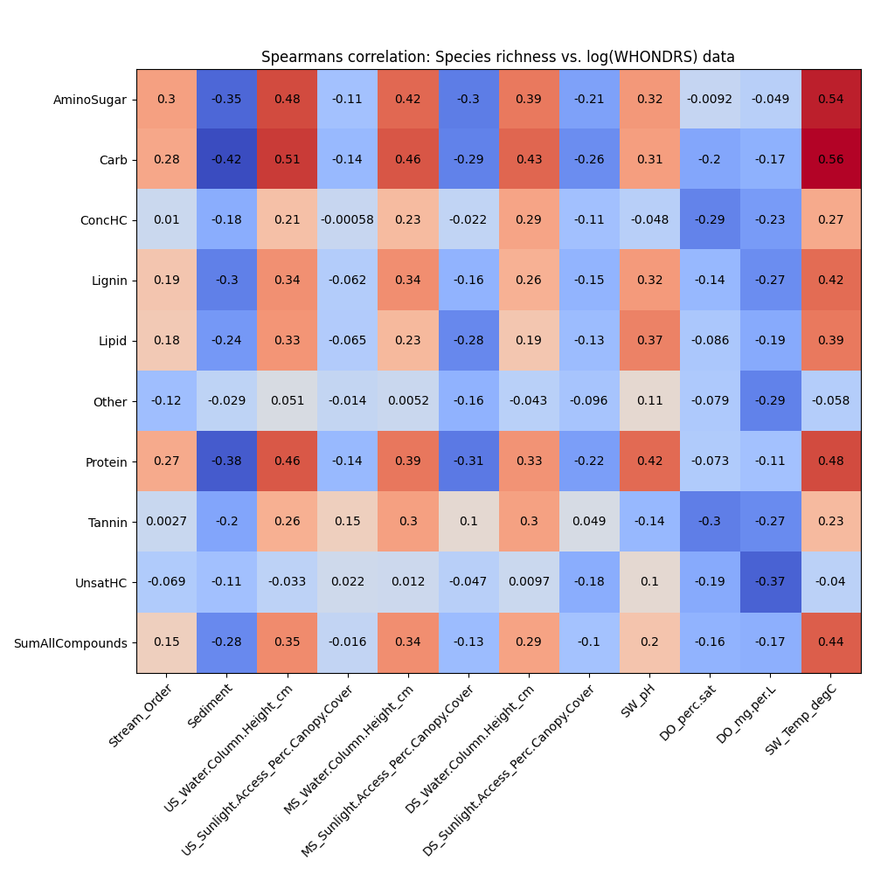
Pearsons and Spearsman correlation plots (WHONDRS)
Notes:
Pick top-5 variables across the data and plot in a heatmap

Slide 2
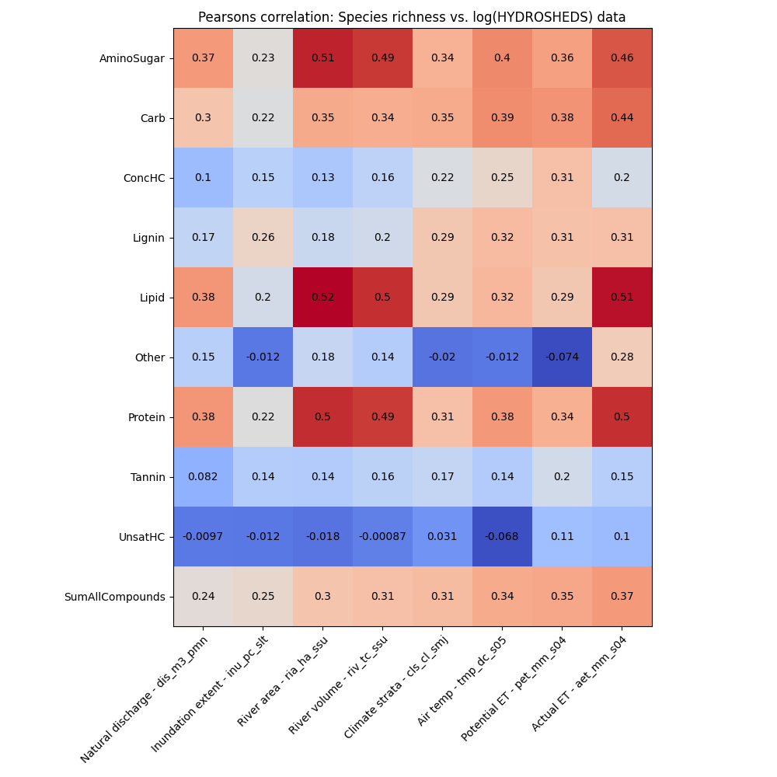
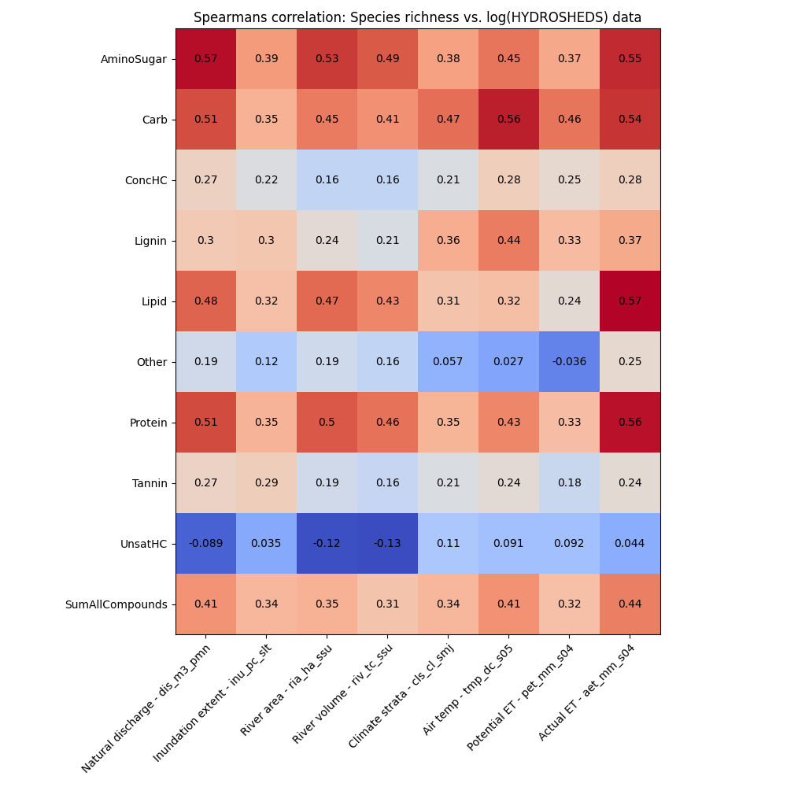
Pearsons and Spearsman correlation plots (HydroSheds)

Slide 3
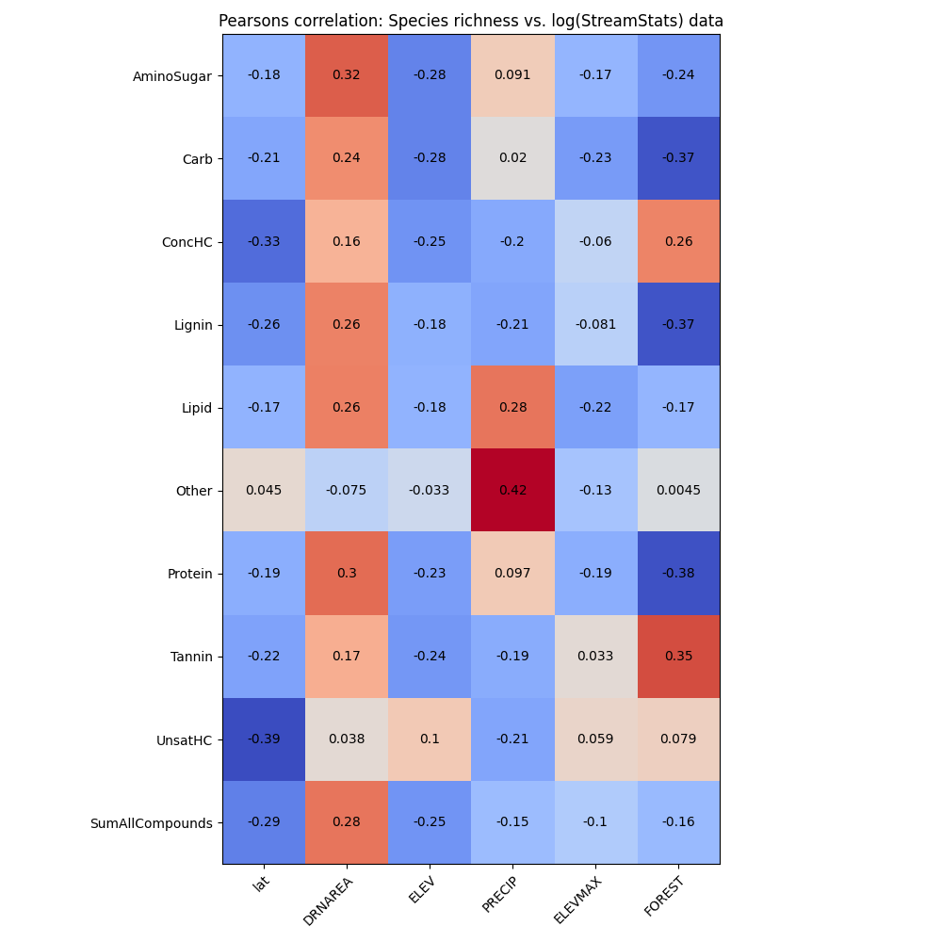
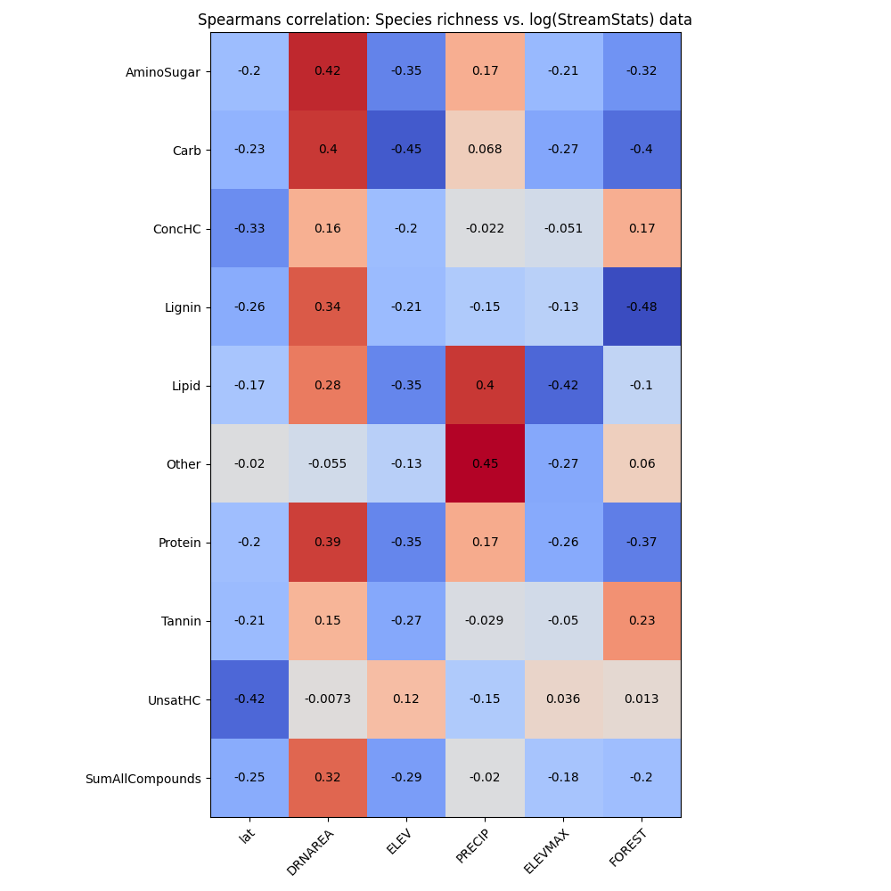
Pearsons and Spearsman correlation plots (StreamStats)
Notes:
0. Shannon diversity is proxy for species richness
Change the color for the heatmap
Blue (positive) and red (negative) colors
Explore biogeochemical transformation metric (how many compounds have changed) is correlating better than species richness

Slide 4
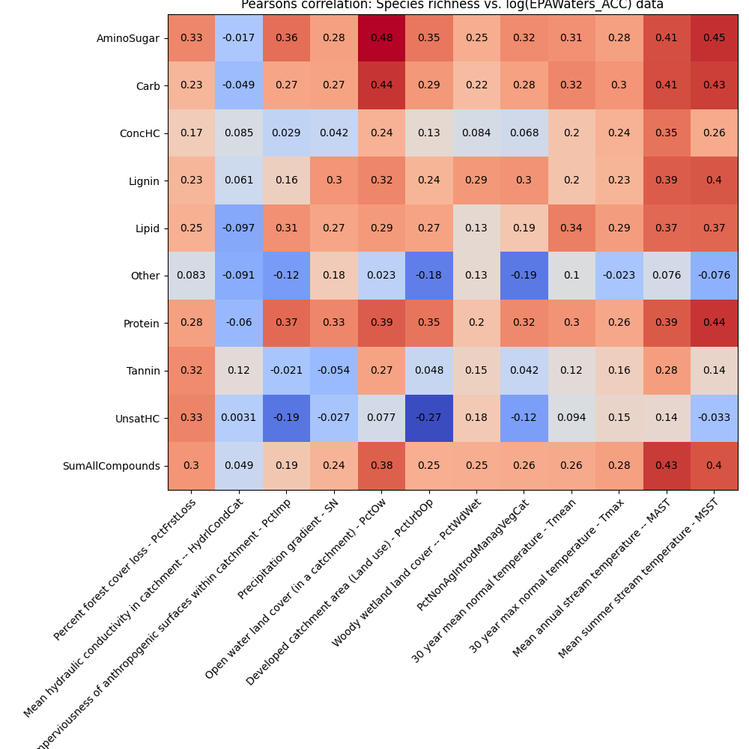
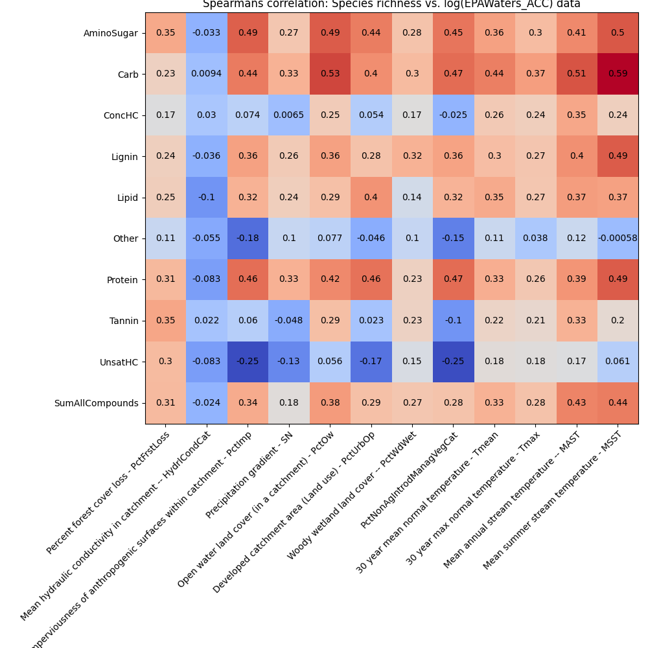
Pearsons and Spearsman correlation plots (EPAWaters-Catchment)

Slide 5
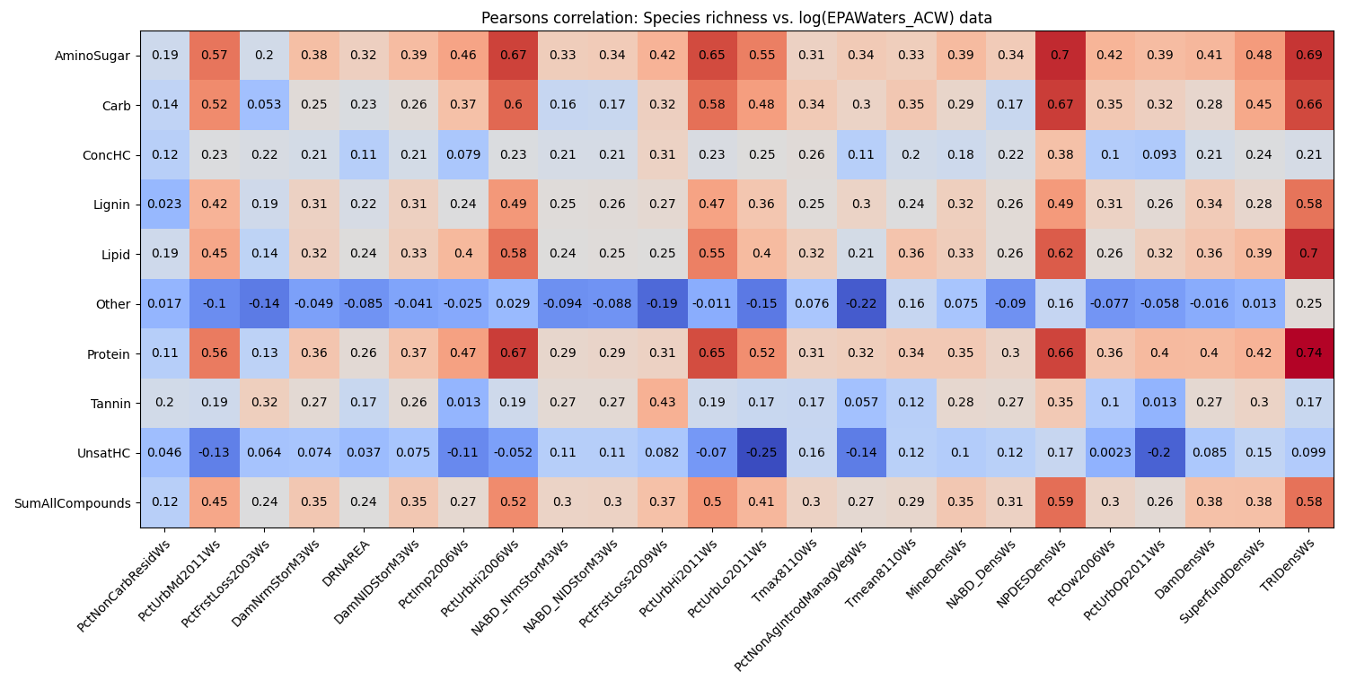
Pearsons correlation plots (EPAWaters-Watershed)

Slide 6
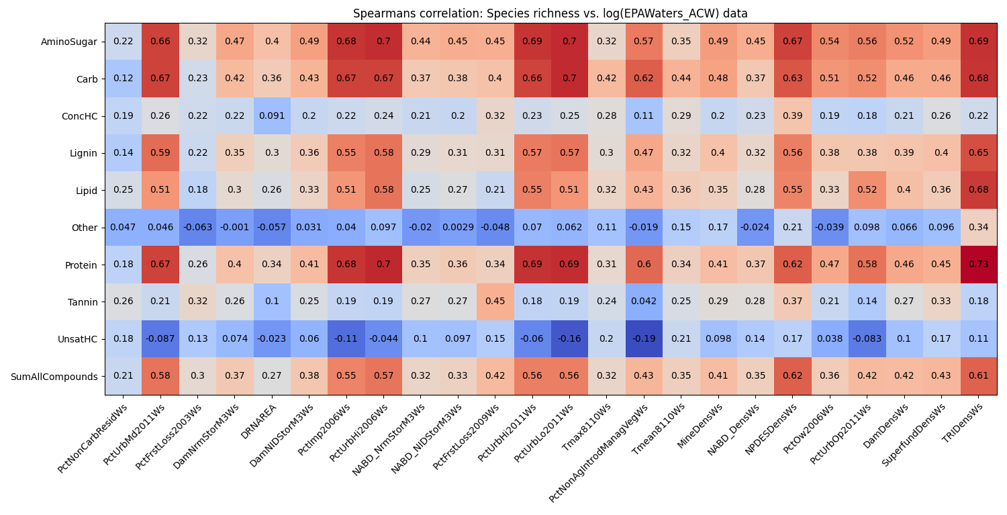
Spearsman correlation plots (EPAWaters-Watershed)
Notes:
Proportional to total sum --> and re-run the analysis
Which compounds among the 9 drive the linear and non-linear correlation (within aminosugar class that are group together)
Compute p-value threshold and reduce the figure (check in python)
Model building – RDA model approach
PCA plots, which PCA components are important in explaining and see the features in the PCA components
Slope with color and correlation indicated by star
Provide a dataframe to James
Look for beta regression (logit-regression or Gaussian regression or Poisson data) between Species richness and Extrinsic factors
If proportion data, revisit the analysis.

Slide 7
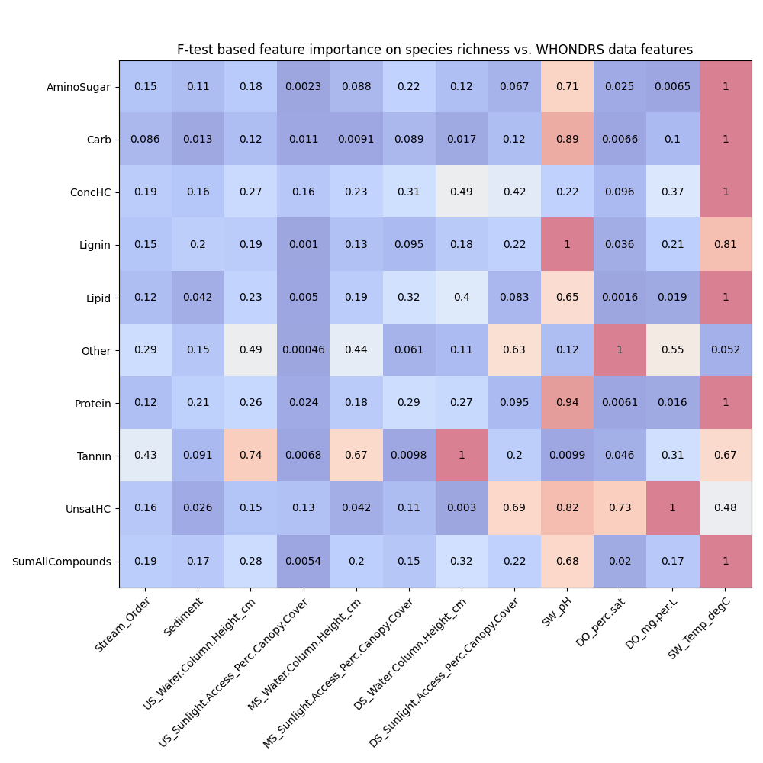
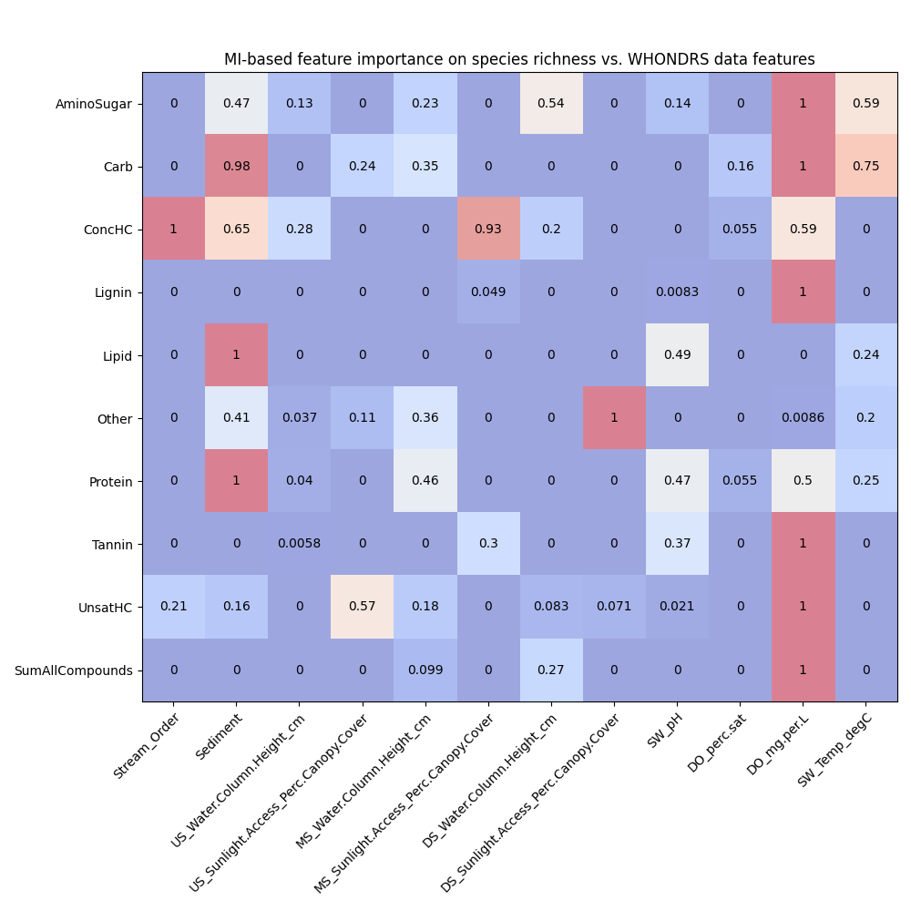
Feature importances using F-test and Mutual Information (WHONDRS)

Slide 8
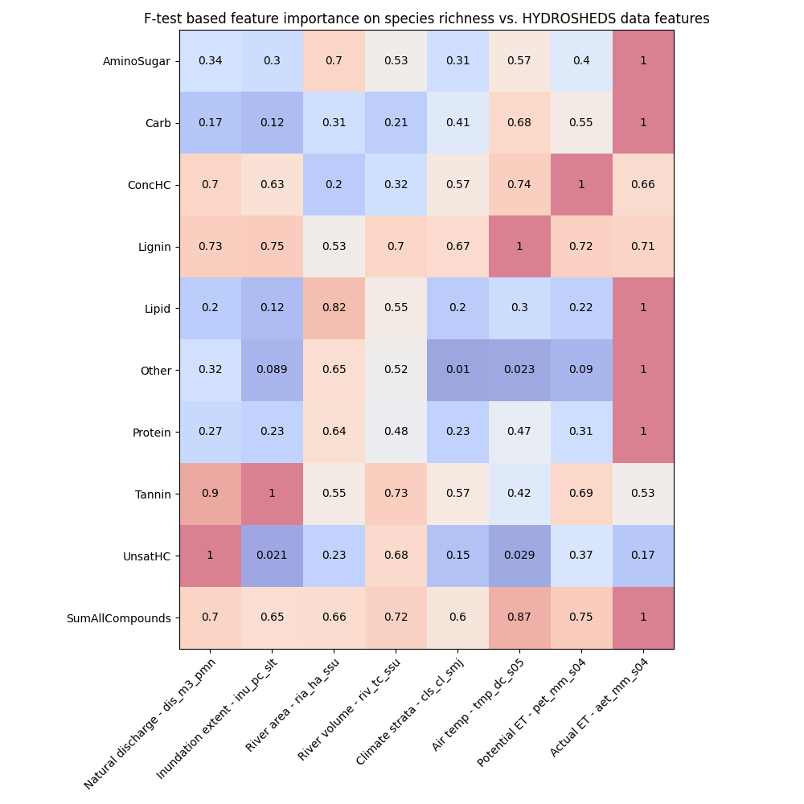
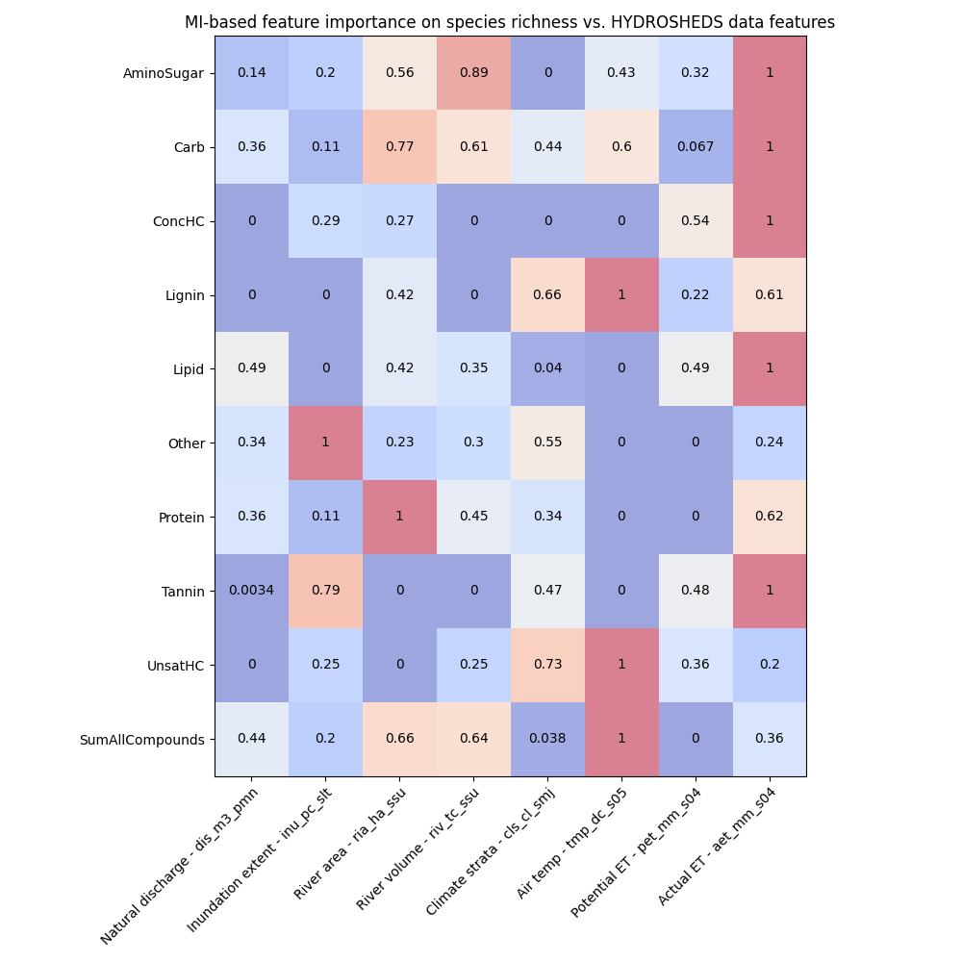
Feature importances using F-test and MI (HydroSheds)

Slide 9
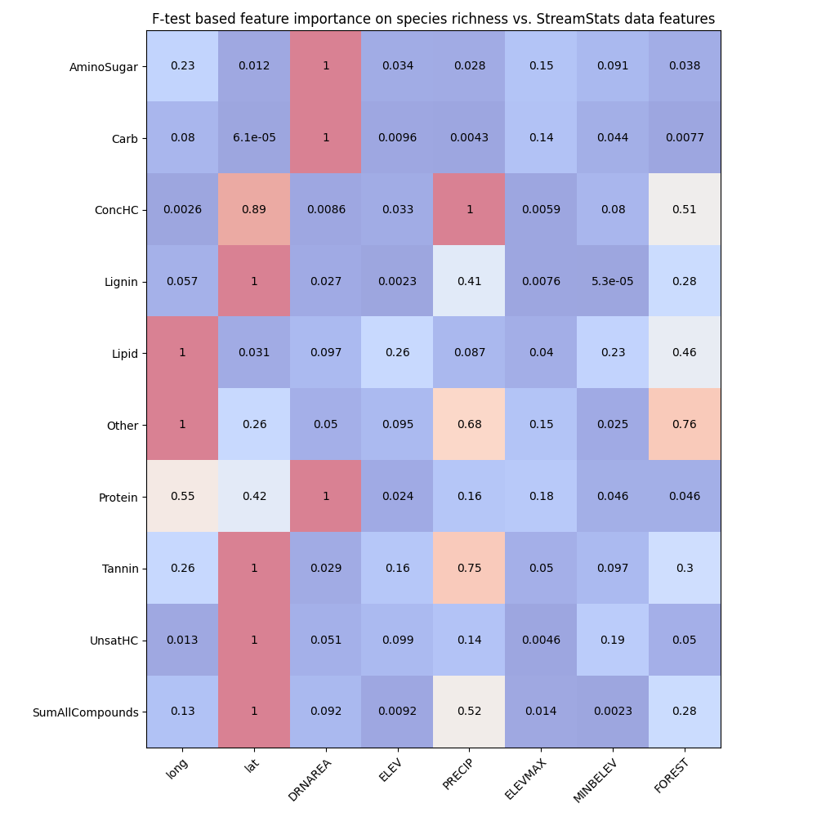
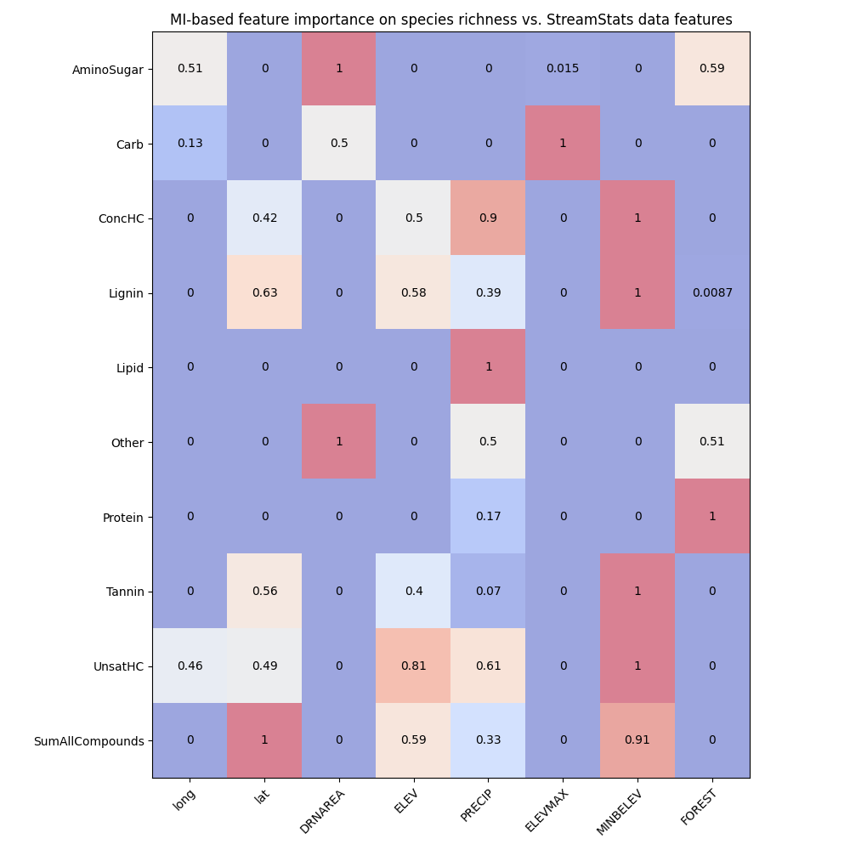
Feature importances using F-test and MI (StreamStats)

Slide 10
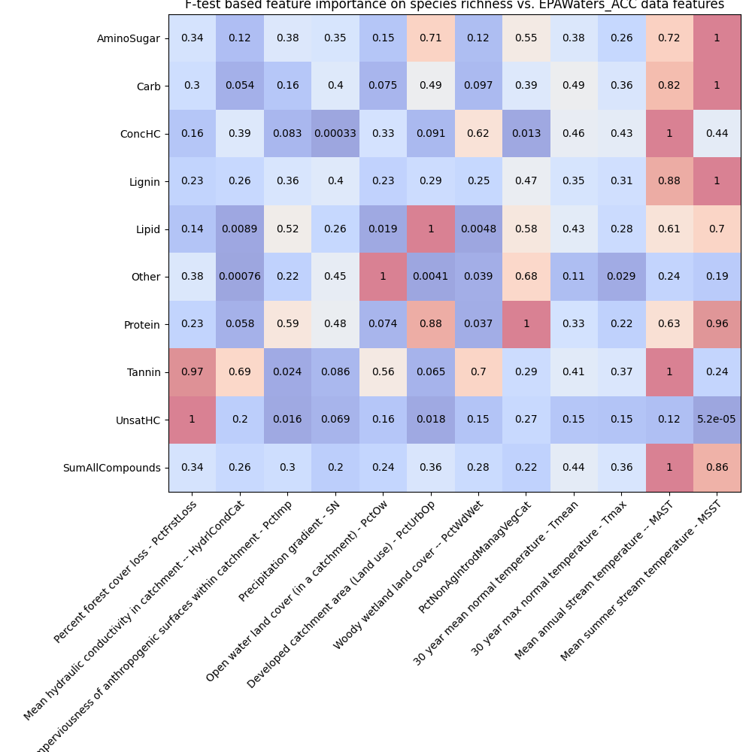
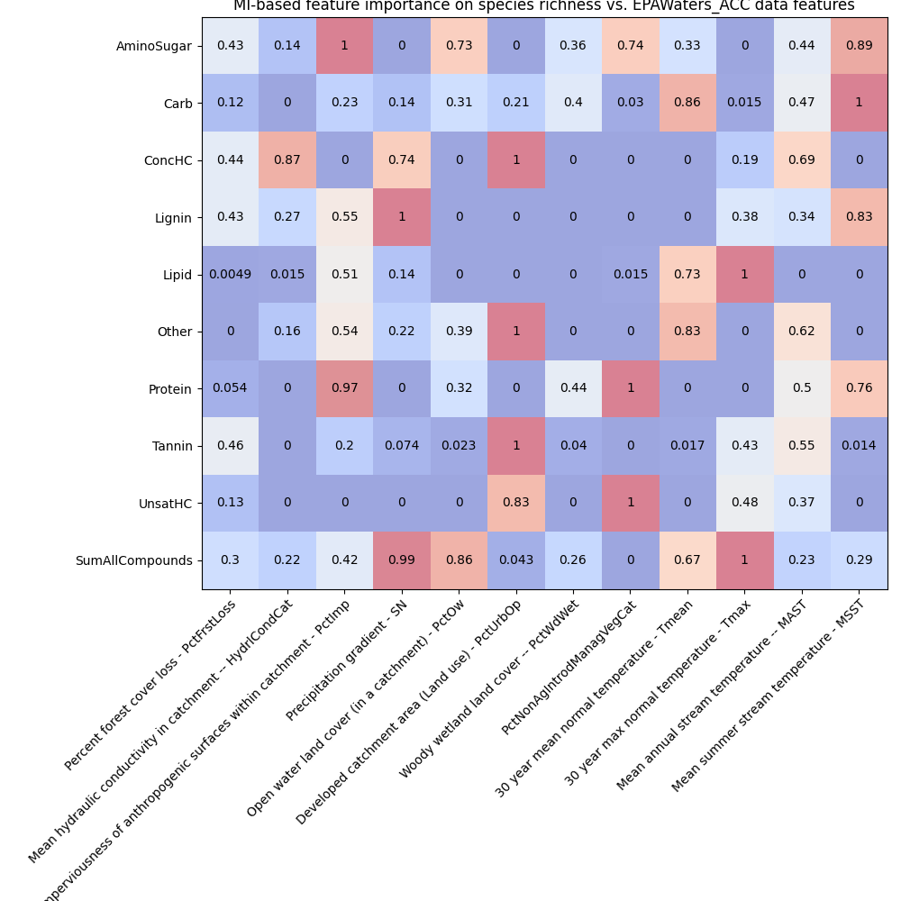
Feature importances using F-test and MI (EPAWaters-Catchment)

Slide 11
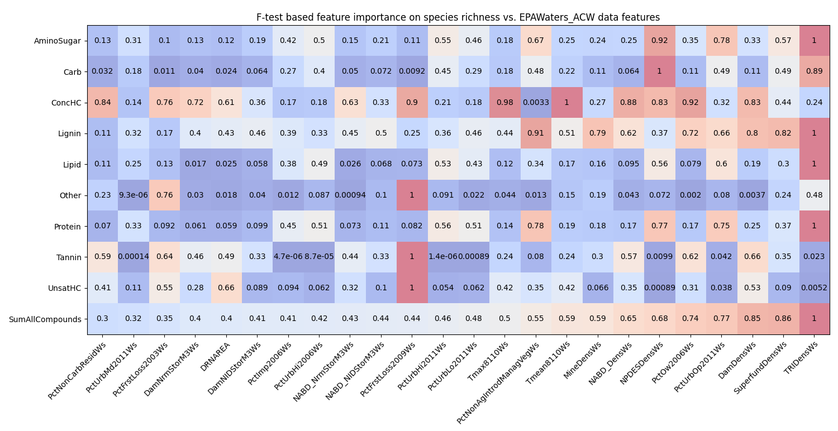
Feature importances using F-test (EPAWaters-Watershed)

Slide 12
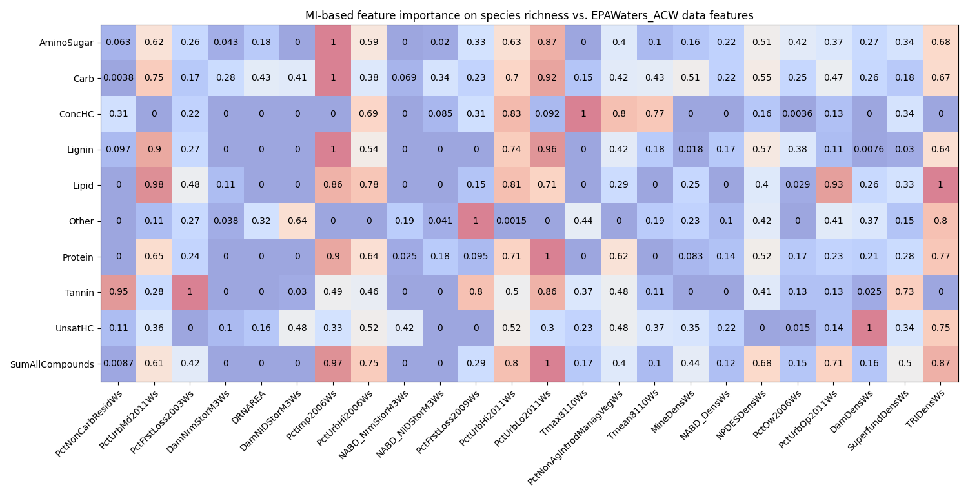
Feature importances using MI (EPAWaters-Watershed)

Slide 13
Feature importances using F-test and Mutual Information (WHONDRS)

Slide 14
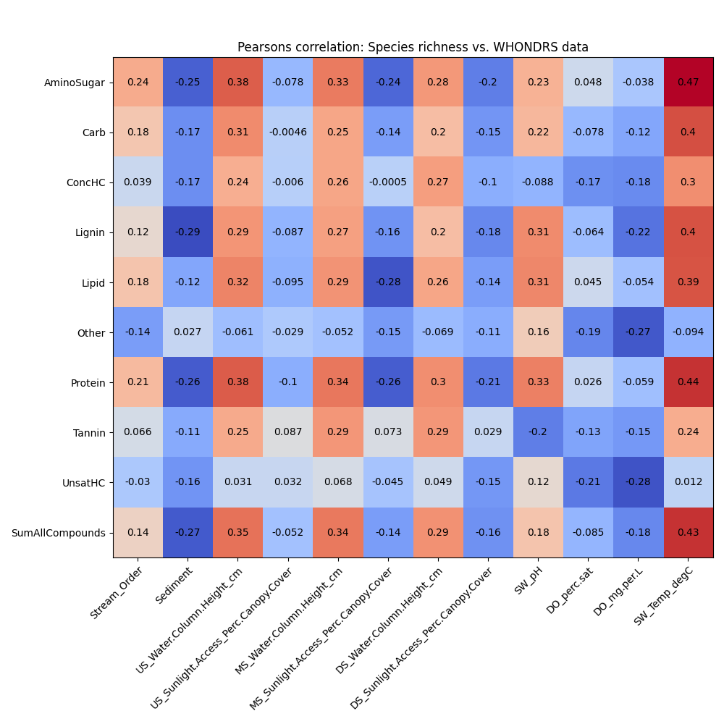

Correlation plots (SR vs WHONDRS in normal scale)
Notes:
Pick top-5 variables across the data and plot in a heatmap

Slide 15
Finding correlation between species richness and environmental variables
Metric/Descriptor of intrinsic variables
Species richness
This is estimated from the sample site data
Metrics/Descriptors of extrinsic variables
WHONDRS metadata for these sites
Surface water temperature
Dissolved oxygen
pH
Stream order
Correlation plots between species richness and log(WHONDRS data)

Slide 16
Pearson’s and Spearsman’s correlation plots (SR vs log-scale in WHONDRS)
Notes:
Pick top-5 variables across the data and plot in a heatmap

Slide 17
Feature importance among WHONDRS variables
Metric/Descriptor of intrinsic variables
Species richness
This is estimated from the sample site data
Metrics/Descriptors of extrinsic variables
WHONDRS metadata for these sites
Surface water temperature
Dissolved oxygen
pH
Stream order
Feature importances → X: (all_samples, n_features); Y: (all_samples,)
Pearson correlation
Spearsman correlation
F-test
Mutual information (MI)
Random Forest (RF) with n_trees = 100
SHAPley values (based on RF model)

Slide 18
Feature importances – Pearsons and spearsman correlations (WHONDRS)

Slide 19
Feature importances using F-test and Mutual Information (WHONDRS)

Slide 20
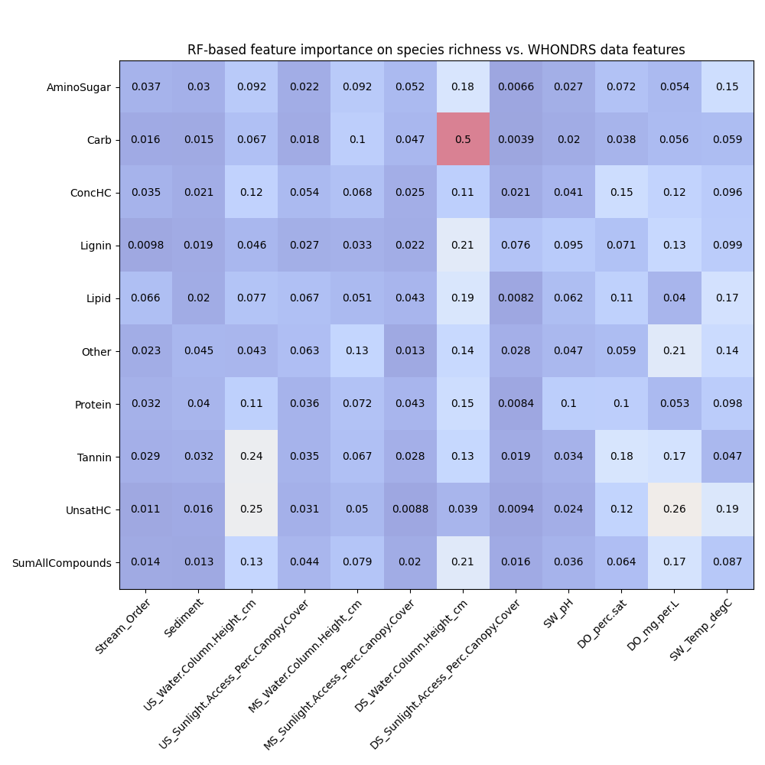
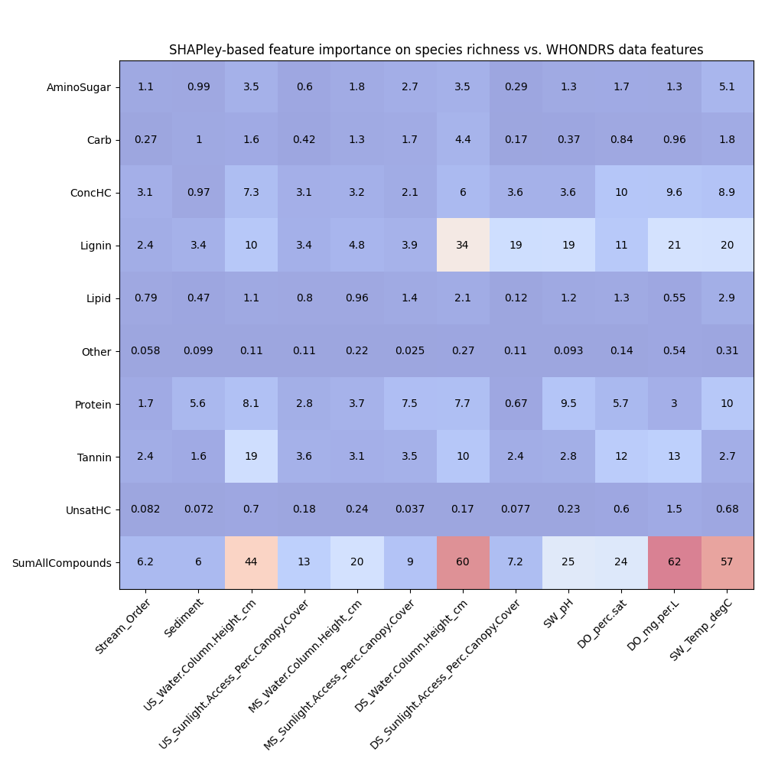
Feature importances using RF and SHAPley (WHONDRS)

Slide 21
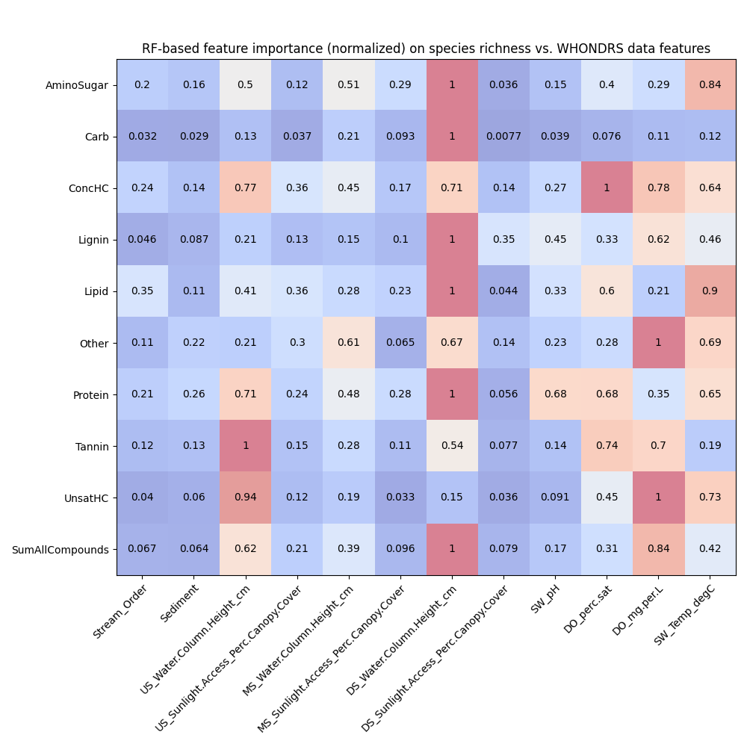
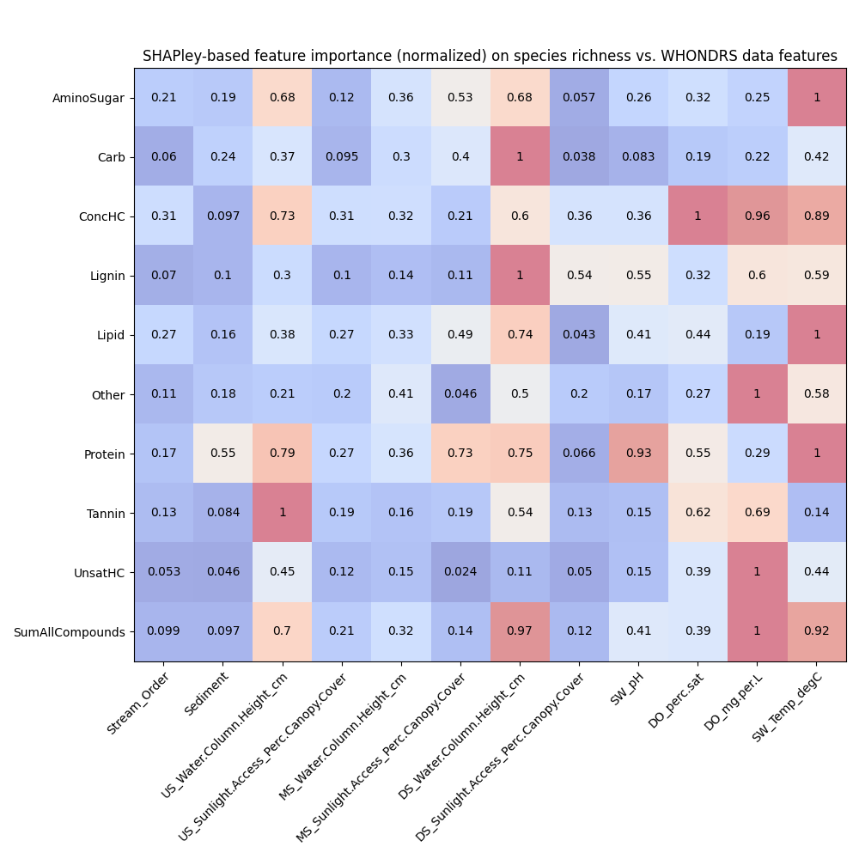
Feature importances using RF and SHAPley normalized (WHONDRS)

Slide 22
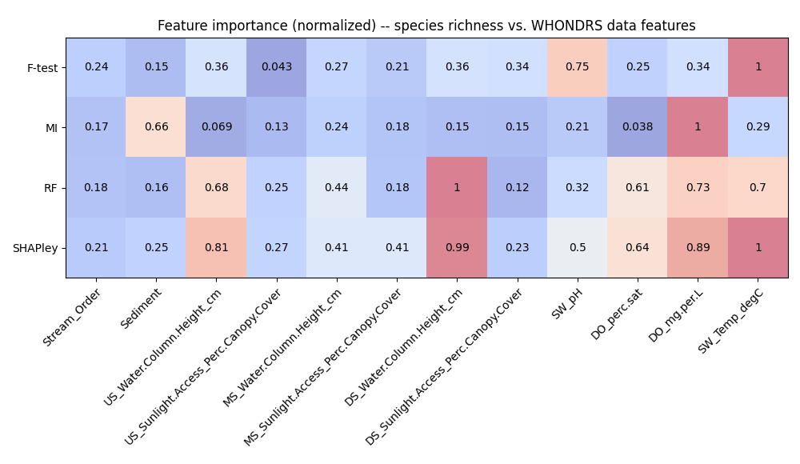
Feature importances among WHONDRS variables

